Slide 1
Turtle graphics

Slide 2
Turtle graphics
Python has a turtle graphics system that simulates a robotic turtle.
The Python turtle graphics simulates a “turtle” that follow commands to draw simple graphics
The turtle had a pen that could be raised and lowered, so it could be placed on a sheet of paper and programmed to draw images.
You can use Python statements to move the turtle around the screen, drawing lines and shapes.
To use Python’s turtle graphics system:
import turtle
turtle.showturtle()#display arrowhead
The turtle doesn’t look like a turtle at all. Instead, it looks like an arrowhead

Slide 3
Turtle graphics
Drawing Lines with the Turtle turtle.forward(n) :command to move the turtle forward n pixels .
turtle.forward(100) Turning the Turtle You can turn the turtle in different direction by using either
turtle.right(angle) command:
It rotates in-place angle degrees clockwise direction
turtle.left(angle) command :
It rotates in-place angle degrees anticlockwise direction. Setting the Turtle’s Heading to a Specific Angle
turtle.setheading(angle)

Slide 4
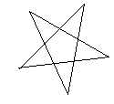
Example
Turtle graphics
import turtle
turtle.showturtle()
turtle.setheading(45)
#turtle.right(45)
turtle.delay(100)#set the #drawing delay in milliseconds
turtle.forward(100)#forward in the #direction of arrow 100 pixels
turtle.right(145)
turtle.forward(100)
turtle.right(145)
turtle.forward(100)
turtle.right(145)
turtle.forward(100)
turtle.right(143)
turtle.forward(100)
turtle.hideturtle()
turtle.exitonclick()
#turtle.pendown()
#turtle.pencolor("red")

Slide 5
Turtle graphics
Drawing Circles and Dots turtle.circle(100) turtle.dot() Changing the Pen Size turtle.pensize(width) command to change the width of the turtle’s pen, in pixels. Changing the Drawing Color turtle.pencolor('red’) Changing the Background Color turtle.bgcolor('gray’) Specifying the Size of the Graphics Window turtle.setup(width, height) command to specify a size for the graphics window turtle.setup(640, 480) | Moving the Turtle to a Specific Location turtle.goto(x, y) command to move the turtle from its current location to a specific position in the graphics window Controlling the Turtle’s Animation Speed turtle.speed(speed): speed range 0(animation disabled) to 10 Displaying Text in the Graphics Window turtle.write(text) Filling Shapes To change the fill color use the turtle.fillcolor(color) To fill a shape with a color, you use the turtle.begin_fill() command before drawing the shape, then you use the turtle.end_fill() command after the shape is drawn.

Slide 6
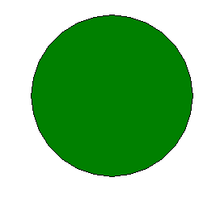
Example
Turtle graphics
import turtle
turtle.hideturtle()
turtle.fillcolor('green')
turtle.begin_fill()
turtle.circle(100)
turtle.end_fill()
turtle.exitonclick()

Slide 7
Turtle Graphics: Using Loops to Draw Designs
Turtle graphics
You can use loops with the turtle to draw both simple shapes and elaborate designs. For example, the following for loop iterates four times to draw a square that is 100 pixels wide:
import turtle
turtle.hideturtle()
for x in range(4):
turtle.forward(100)
turtle.right(90)
turtle.exitonclick()

Slide 8
Turtle Graphics: Using Loops to Draw Designs
Turtle graphics
This for loop iterates eight times to draw the octagon:
import turtle
for x in range(8):
turtle.forward(100)
turtle.right(45)
turtle.hideturtle()

Slide 9
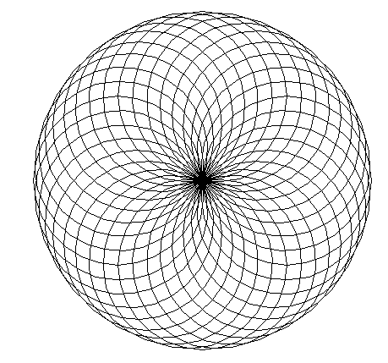
Turtle Graphics: Using Loops to Draw Designs
Turtle graphics
You can create interesting designs by repeatedly drawing a simple shape, with the turtle tilted at a slightly different angle each time it draws the shape.
import turtle
NUM_CIRCLES = 36 # Number of circles to draw
RADIUS = 100 # Radius of each circle
ANGLE = 10 # Angle to turn
for x in range(NUM_CIRCLES):
turtle.circle(RADIUS)
turtle.left(ANGLE)
turtle.exitonclick()

Slide 10
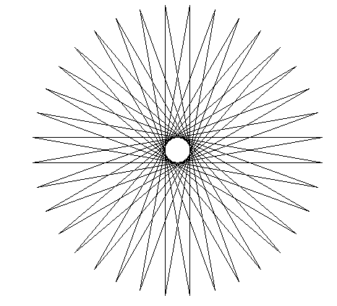
Turtle Graphics: Using Loops to Draw Designs
Turtle graphics
This code draws a sequence of 36 straight lines to make a "starburst" design.
import turtle
START_X = -200 # Starting X coordinate
START_Y = 0 # Starting Y coordinate
NUM_LINES = 36 # Number of lines to draw
LINE_LENGTH = 400 # Length of each line
ANGLE = 170 # Angle to turn
turtle.hideturtle()
turtle.penup()
turtle.goto(START_X, START_Y)
turtle.pendown()
for x in range(NUM_LINES):
turtle.forward(LINE_LENGTH)
turtle.left(ANGLE)
turtle.exitonclick()

Slide 11
End!!!

